Slide 1
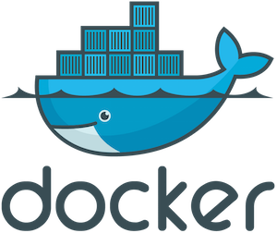
Monitoring Containers with the ELK Stack

Slide 2
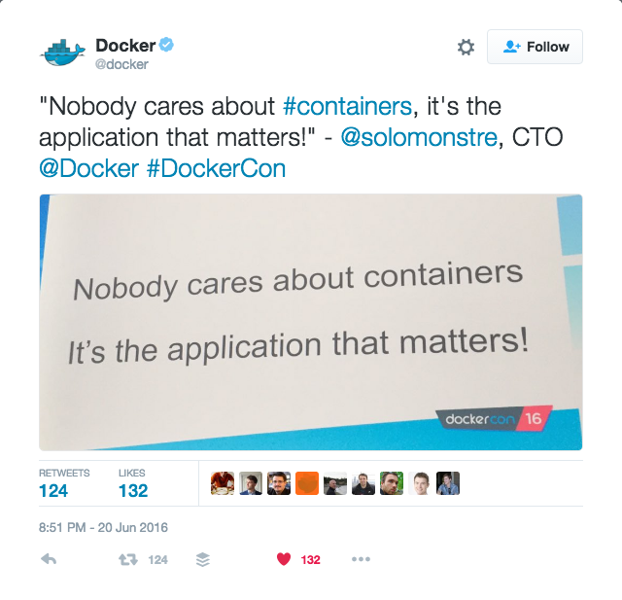

Solomon Hykes, DockerCon 2016
Notes:
Need to start looking at our Docker environment from a more high level view.
This talk will also try and approach Docker from a more holistic point of view.

Slide 3
Daniel Berman
Product Evangelist @Logzio
LAMPer
Contributor on SitePoint and DZone
TLV-PHP Meetup organizer
@proudboffin, daniel@logz.io

Slide 4
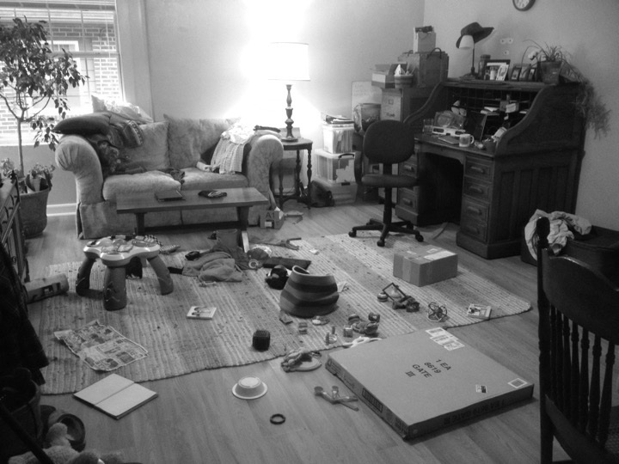
Notes:
One picture is worth 1000 words!
Chaos

Slide 5
2-Mins on
End-to-end ELK as a service
Auto-scaling, secure
SOC-II compliant, ISO27001
AWS-based
Alerting, user-control, ELK Apps

Slide 6
Agenda
Why logging?
The logging challenge
The Docker challenge
Common logging solutions
Introducing ELK
Docker log collector
Demo
Questions?

Slide 7












Why logging?
RFID
Windows
App
Database
asd
Sensors
App server
Network
Security
Mainframe
Active directory
Exchange
Web server
Notes:
Logging is hands down the best way to see how your application is behaving, and when utilized properly allows you to catch problems early and make key technical decisions.
IT infrastructures on the cloud

Slide 8
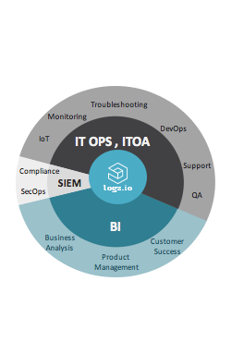
State of logging
Notes:
Multiple use cases across operations, security, BI and IoT

Slide 9
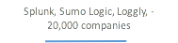
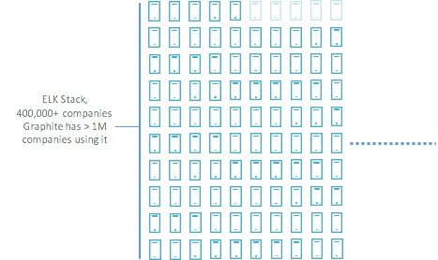




The shift to open source
Notes:
Log analytics market - divided into two disproportionate parts
Splunk invented the space, small section of the market. Majority of the market are using ELK. Open source sitting on the convergence of various log analytics software: Hadoop, Spark, Elasticsearch
Hadoop, Spark, Graphite, Kafka…ELK!

Slide 10
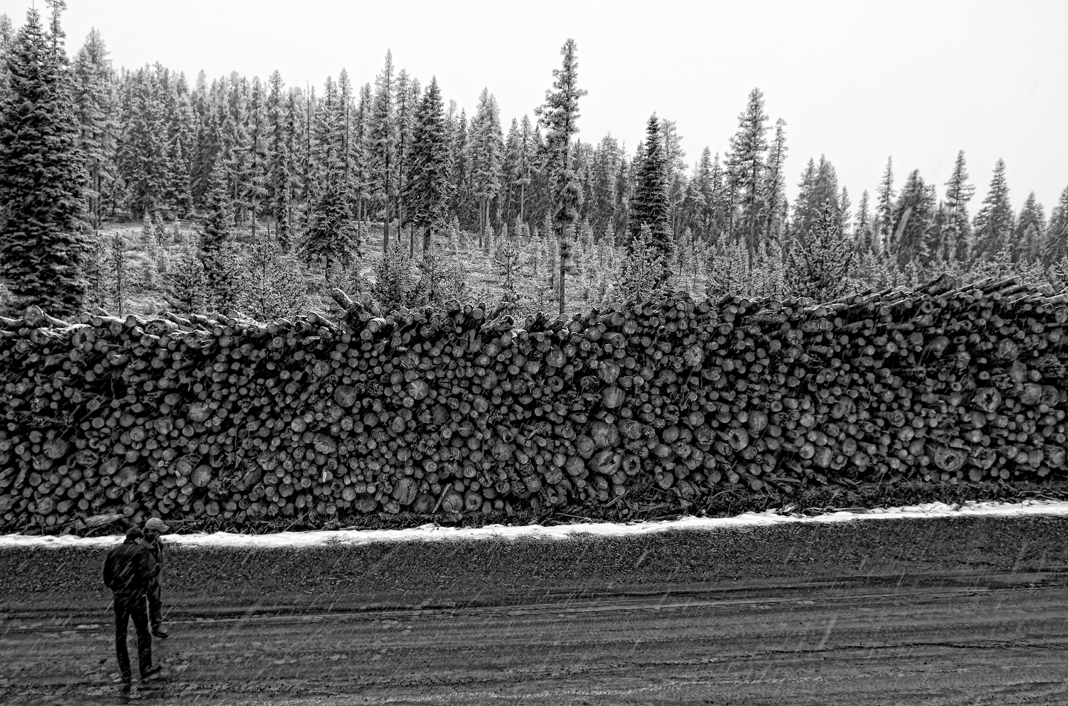
The logging challenge
Notes:
Log analysis is like automated testing. Everyone know they need to do it, but no one ever does do it.

Slide 11
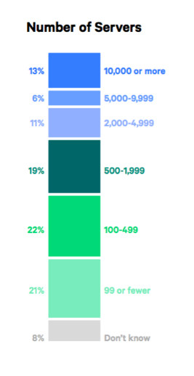
The logging challenge
No centralization
No consistency
No accessibility
* Puppet DevOps Survey 2016
Notes:
Logs are coming in from a huge amount of servers all over the place - they can be on the cloud, local or hybrid. Puppet survey.
Logging is different for each app/system: PHP/node, apache/nginx
Large production environments consist of hundreds of servers
Large data volume, difficult to find - remote access, authentication
SSHing + GREPing is simply not enough

Slide 12

The Docker challenge

Slide 13
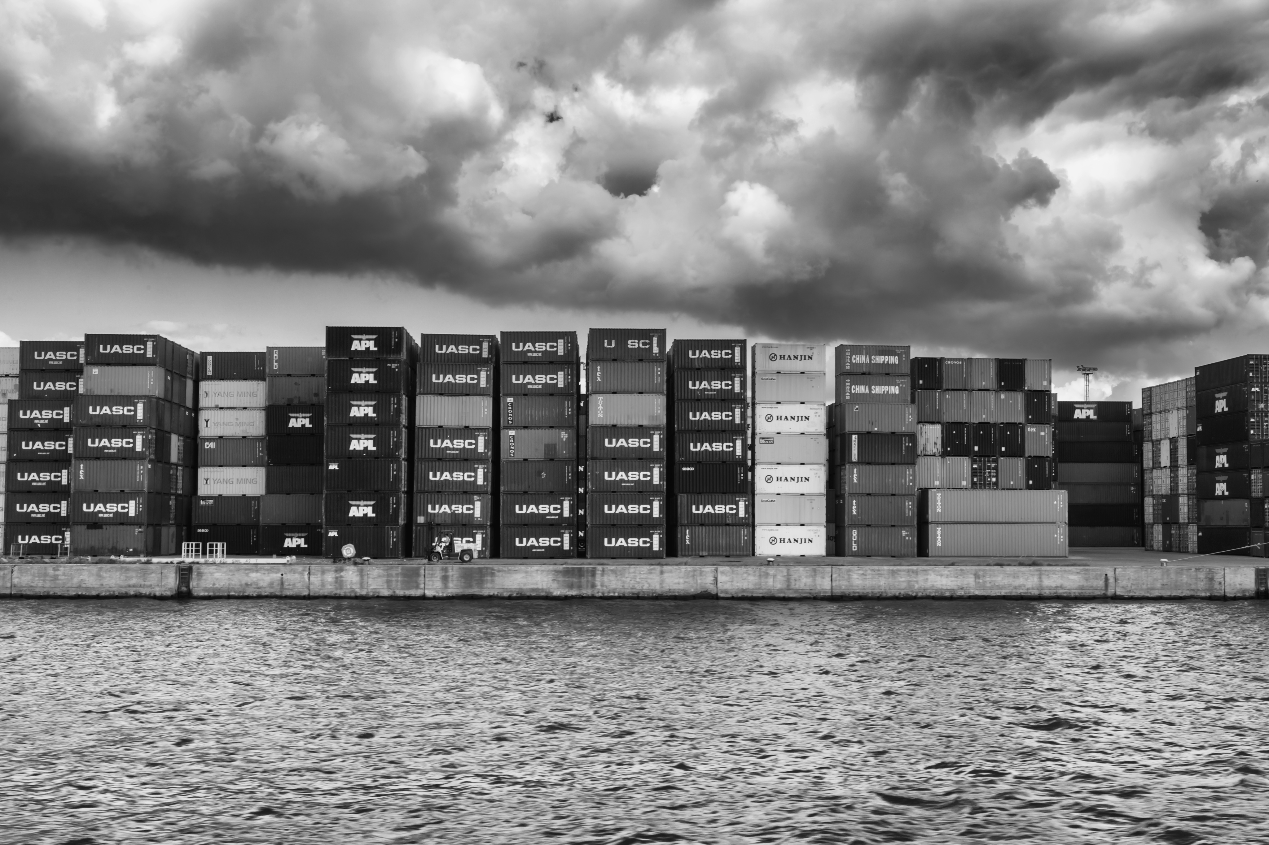
Distribution and diversification
Notes:
Multiple containers per host, each with its own env, dedicated process - monitoring logs for each container is not a viable option
Number of processes running within the same container
Logz.io: 60 hosts running at any given time, each with a number of containers

Slide 14
$ docker logs
2016-06-02T13:05:22.614090Z 0 [Note] InnoDB: 5.7.12 started; log sequence number 2522067
$ docker stats
CONTAINER CPU % MEM USAGE / LIMIT MEM % NET I/O BLOCK I/O
3747bd397456 0.01% 3.641 MB / 2.1 GB 0.17% 3.366 kB / 648 B 0 B / 0 B
396e42ba0d15 0.11% 1.638 MB / 2.1 GB 0.08% 9.79 kB / 648 B 348.2 kB / 0 B
468bf755240a 3.19% 45.67 MB / 2.1 GB 2.17% 25.19 MB / 17.95 MB 774.1 kB / 0 B
5f16814a3c0e 0.01% 495.6 kB / 2.1 GB 0.02% 8.564 kB / 648 B 0 B / 0 B
74cdfa7b8a0c 0.04% 3.908 MB / 2.1 GB 0.19% 2.028 kB / 648 B 0 B / 0 B
99bafb7600fc 0.00% 32.95 MB / 2.1 GB 1.57% 0 B / 0 B 2.093 MB / 20.48 kB
a48f7ba0ace7 0.04% 390.4 MB / 2.1 GB 18.59% 4.704 kB / 648 B 31.29 MB / 306.5 MB
d7b60560e4d8 0.27% 220.9 MB / 2.1 GB 10.52% 7.338 kB / 648 B 94.21 kB / 114.7 kB
$ docker daemon
time="2016-06-05T12:03:49.716900785Z" level=debug msg="received containerd event: &types.Event{Type:\"exit\", Id:\"3747bd397456cd28058bb40799cd0642f431849b5c43ce56536ab7f55a98114f\", Status:0x0, Pid:\"4120a7625a592f7c95eab4b1b442a45370f6dd95b63d284714dbb58f00d0a20d\", Timestamp:0x57541525}"
Notes:
Various types of data being outputted by each container

Slide 15
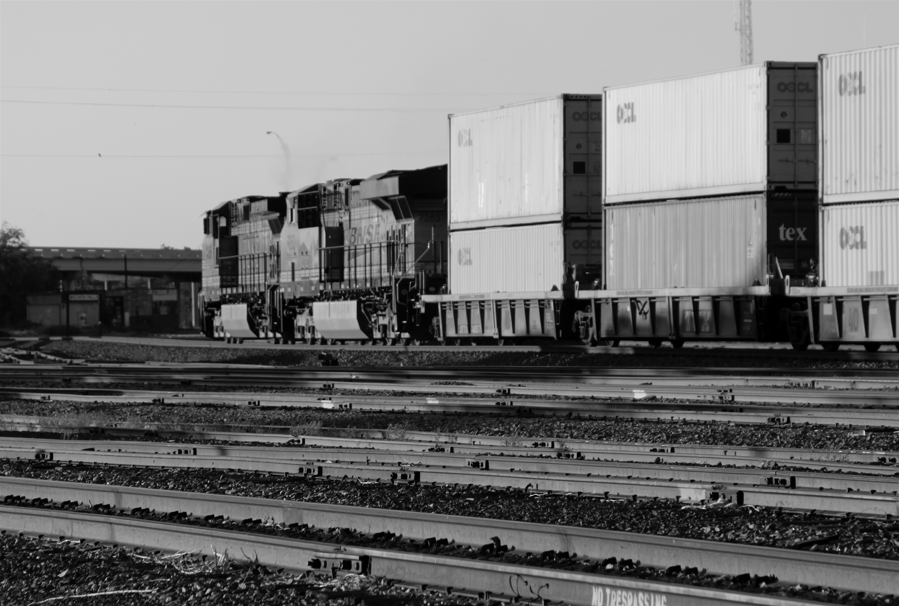
Containers are transient
Notes:
Traditional logging and monitoring took metrics static servers with long uptime
Containers come and go, constantly moving, dynamic - some Docker servers run hundreds of short-term containers s
You can’t log to the container since the data will be lost

Slide 16
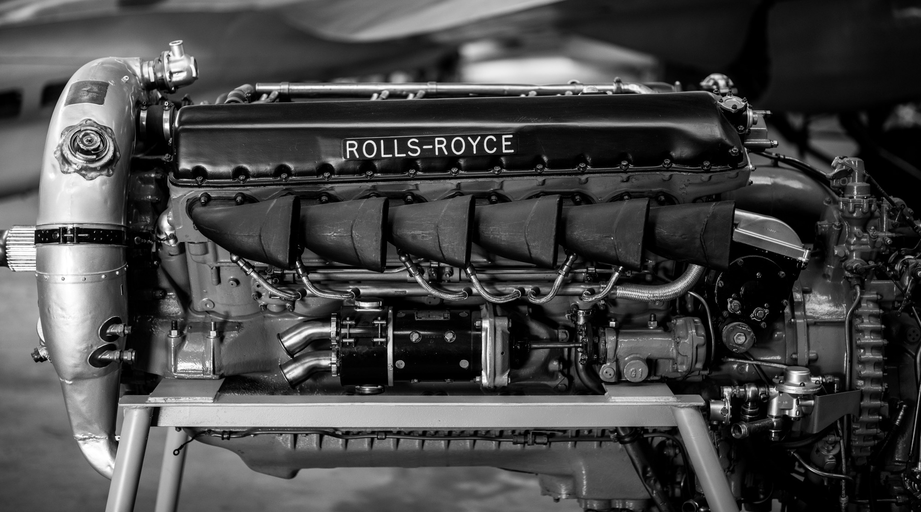
$ tail -f
is not enough
Notes:
Data is no longer persistent and accessible, in the container era - data is ephemeral and distributed, turning log analytics into an engineering art
Log analytics has become black magic - not unprone to human mistakes and errors.

Slide 17
Common logging solutions
Application logging (data volumes)
Logspout
Drivers - json-file (default), syslog, fluentd, gelf, journald
Monitoring/Logging tools - Datadog, Papertail, Dynatrace, Sysdig
Notes:
Application logging using data volumes - app handles logging using a logging framework, drawbacks: requires setup in app, no stats/events
Logspout - runs as a container per host, drawbacks: only for stdout/stderr, no stats/events, not meant for management so no retention. Extremely popular (Datadog research)
Drivers - drawbacks: tough to troubleshoot and administrate, miss out on daemon events and stats, requires extra config
SaaS - cost, focus on monitoring metrics

Slide 18



Introducing ELK
World’s most popular open source log analysis platform
4.5M downloads a month!
Centralized logging AND: search, BI, SEO, IoT, and more
Notes:
Why so popular?
Simple and beautiful! Easy to get started UI is awesome!
Open Source and free!
Fast, very fast!

Slide 19
Old school logging
$ grep ' 30[1234] ' /var/logs/apache2/access.log | grep -v
baidu | grep -v Googlebot
173.230.156.8 - - [04/Sep/2015:06:10:10 +0000] "GET /morpht HTTP/1.0" 301 26
"-" "Mozilla/5.0 (pc-x86_64-linux-gnu)"
192.3.83.5 - - [04/Sep/2015:06:10:22 +0000] "GET /?q=node/add HTTP/1.0" 301
26 "http://morpht.com/" "Mozilla/5.0 (Macintosh; Intel Mac OS X 10_10_1)
AppleWebKit/600.2.5 (KHTML, like Gecko) Version/8.0.2 Safari/600.2.5"
192.3.83.5 - - [04/Sep/2015:06:10:23 +0000] "GET /?q=user/register HTTP/1.0"
301 26 "http://morpht.com/node/add" "Mozilla/5.0 (Macintosh; Intel Mac OS X
10_10_1) AppleWebKit/600.2.5 (KHTML, like Gecko) Version/8.0.2 Safari/600.
2.5"
Notes:
Website down scenario

Slide 20
New school logging
type:apache AND website: "mysite" AND response: [500 TO *]

Slide 21
A full-text search & analytics engine
Open source, written in Java and based on Apache Lucene
Designed for speed, scalability and high availability
Advanced querying using REST API
Notes:
Distributed architecture (sharding, replication) allows for huge capacity, scaling up to hundreds of servers and storing petabytes of data
On the same hardware, queries that would take more than 10 seconds using SQL will return results in under 10 milliseconds in Elasticsearch.
The result of all this is: a fast, scalable and reliable data store that can power any data discovery application.

Slide 22
Collects, processes, and forwards logs
Over 200 input, filter and output plugins for manipulating the data
Notes:
The stack’s workhorse - can process data from any source
Hundreds of output plugins: AWS S3, MongoDB, Redis, Riak and many more

Slide 23
Open source visualization platform
For querying and analyzing logs
Visualizations and monitoring dashboards

Slide 24



The ELK pipeline

Slide 25
Docker —> ELK
Setup ELK: Install Elasticsearch, Logstash and Kibana
Elasticsearch - https://hub.docker.com/_/elasticsearch/
Logstash - https://hub.docker.com/_/logstash/
Kibana - https://hub.docker.com/_/kibana/
Full stack: https://hub.docker.com/r/sebp/elk/
Notes:
2225 Elasticsearch images
Over 100K pulls, configures log rotation, certification keys for log shippers.

Slide 26
Docker —> ELK
Use syslog logging driver
logging:
driver: syslog
options:
syslog-address: "udp://$IP_LOGSTASH:5000"
syslog-tag: “nginx-with-syslog"
Use logspout and Logstash module :
input {
udp {
port => 5000
codec => json
}
}
Notes:
In both cases, stdout and stderr output
Downfalls:
Per host
Resource consumption
No stats/events

Slide 27
Docker Log Collector
Dedicated container
Unified logging layer, fetching:
Docker logs from all the running containers per Docker host
Docker stats for all the containers
Docker daemon events
Notes:
Dedicated container making logging a part of the architecture
Simplified scaling - simply run a container
Daemon events: attach, commit, copy, create, destroy, detach, die, etc. — for understanding the lifecycle of containers

Slide 28
How it works
Based on docker-loghose and docker-stats
POST /containers/{id}/attach, to fetch the logs
GET /containers/{id}/stats, to fetch the stats of the container
GET /containers/json, to detect the containers that are running when this module starts
GET /events, to detect new containers that will start after the module has started

Slide 29
Running it
$ docker pull logzio/logzio-docker
$ docker run -d --restart=always -v /var/run/docker.sock:/var/run/docker.sock logzio/logzio-docker -t UfKqCazQjUYnBNcJqSryIRyDIjExjwIZ
Notes:
On GitHub, so you can customize it any way you want.

Slide 30
Running options
-- no-stats, to not send stats
-- no-logs, to not send logs
-- no-dockerEvents, to not send daemon events
-i/-- statsinterval, to set the stats interval
-a, custom tag
-- matchByName / -skipByName, blacklist or whitelist containers

Slide 31
What metrics to look out for
Errors and warnings
Container CPU%
Container memory usage
# of running containers
Network usage
Notes:
Errors and warnings
Container CPU% - will help you set CPU limits for containers
Container memory usage - will help you set memory limits for containers
# of running containers - handy during deployments and updates to check that everything is running like before
Network usage

Slide 32
Demo time!

Slide 33

Notes:
No silver bullet! (Bela Lugosi, 1931)
Docker is still not mature enough, does not mean that logging is not necessary!
ELK - is scalable, adds visualization layer, easier centralized analysis

Slide 34
Resources
Logz.io blog: http://logz.io/blog/
Elastic: https://www.elastic.co/learn
Loggly blog: https://www.loggly.com/blog/topic/general/

Slide 35
Thanks!
@proudboffin | daniel@logz.io

Slide 36
Performance agent
$ docker pull logzio/logzio-perfagent
$ docker run -d --net="host" -e LOGZ_TOKEN="UfKqCazQjUYnBNcJqSryIRyDIjExjwIZ"-e USER_TAG="workers" -e HOSTNAME=`hostname` -e INSTANCE="10.1.2.3" --restart=always logzio/logzio-perfagent
Notes:
Monitoring host performance (not just Docker)
collectl
Rsyslog

